Slide 1

Vehicle Valuation System – Mutuka Automotive
Sekwanele Njoko
ITSCA2-12 Scientific Computing with Python
24 June 2026

Slide 2
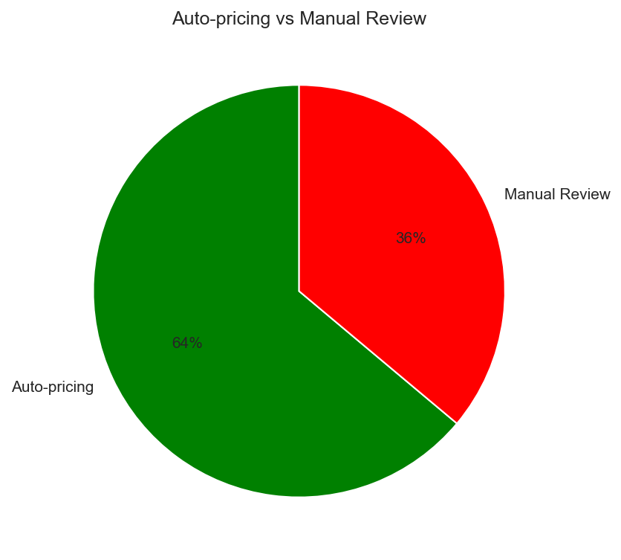
Business Problem
Problem: Manual pricing is slow and inconsistent.
Solution: Data-driven valuation system.
Key Constraints: No mileage, age, or condition data.
Goal: Automate 64% of pricing, flag 36% for manual review.

Slide 3
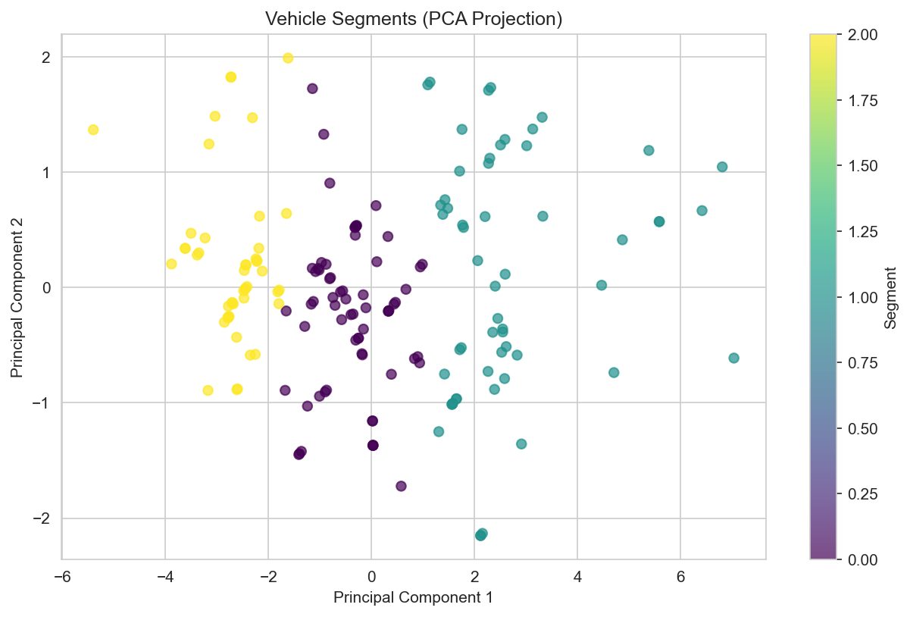
Data & Segmentation (Q1-Q2)
Data: 169 cleaned cars, 26 features.
3 Segments:
Economy (47 cars) – small, efficient
Mid-Range (66 cars) – balanced
Performance/Luxury (56 cars) – large, powerful
Price Bands: Budget, Mid-Range, High-Value, Premium.

Slide 4
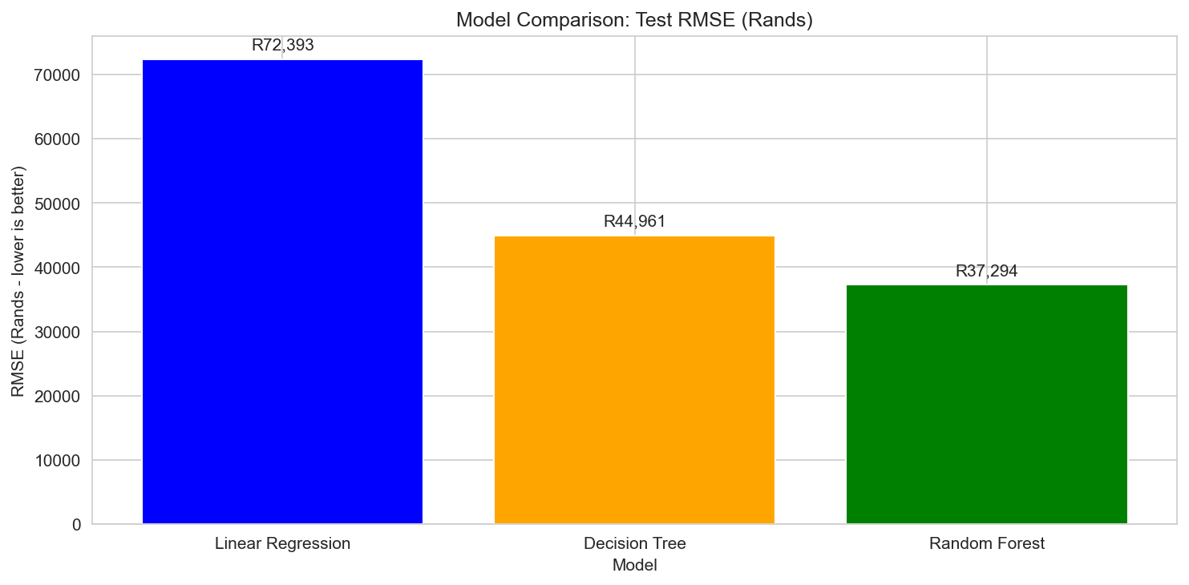
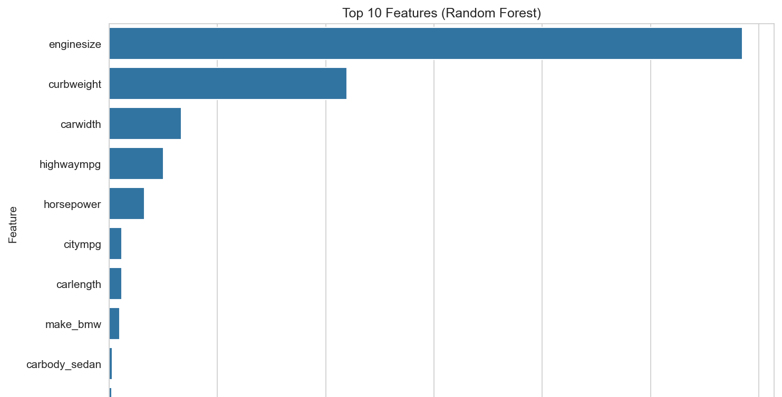
Model Results (Q3)
Best Model: Random Forest
Key Metrics:
R² = 0.951 (explains 95.1% of price variation)
MAE = R25,250 (average error)
MAPE = 8.8% (percentage error)
Feature Importance: Curb weight, engine size, horsepower are top predictors.
Decision Rules (Q4.3)

Slide 5
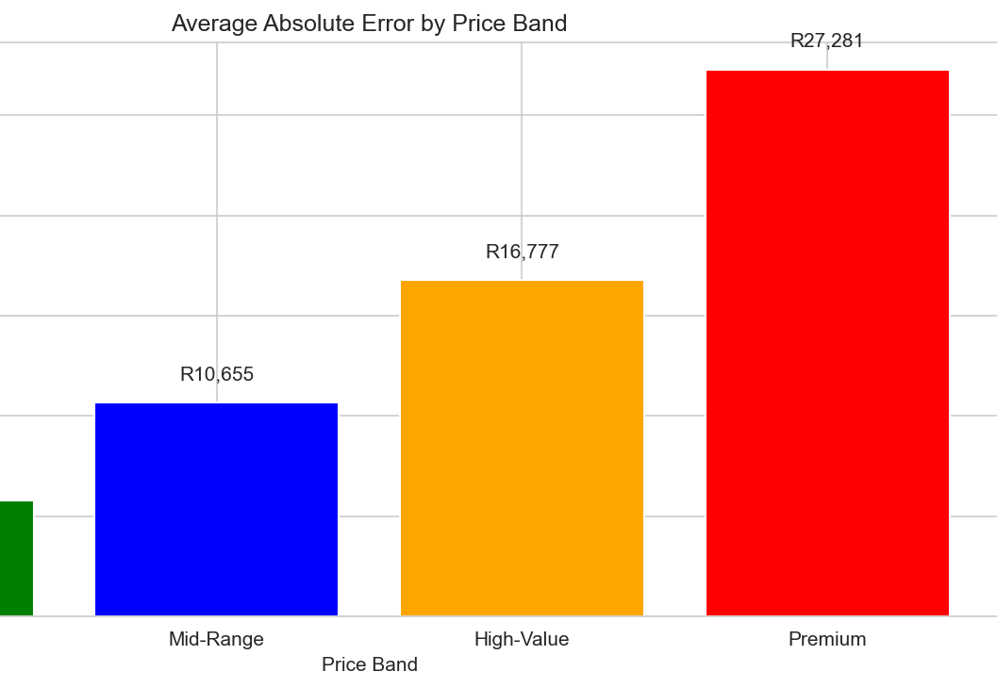
Decision Rules (Q4.3)
Auto-Pricing: Budget/Mid-Range, Economy/Mid-Range segments, hatchbacks/sedans.
Manual Review: Premium, Performance segment, convertibles/hardtops, rare makes.
Coverage: 64% auto-pricing, 36% manual review.

Slide 6
Risks & Recommendations
Biggest Risk: Premium cars are underpriced by ~R16,000.
Do NOT trust: Convertibles, hardtops, Performance segment, rare premium makes.
Recommendation: Partial automation with clear manual review flags.

Slide 7
END

